Slide 1


Web Services Explained
Web Services Explained
Notes:
From the top down:
Browser, HTML, HTTP protocol, TCP/IP, sockets, DNS, routing.
I want to go over the building blocks of a web application. Not just the widgets and HTML & JavaScript source files, but the underlying architecture, from packets on up to pixels, so we can test it from various perspectives.
While it would be tedious to do all of testing at such a low level, sometimes it is useful in troubleshooting difficult problems. And thinking of how the bits move will sometimes help you in planning for security or performance optimizations.
Much of this may already be familiar to you, but bear with me.

Slide 2
What’s a web service?
Web Services Explained

Slide 3

Tools for testing web services

Slide 4
Web Services
Web Services
are applications that
  Are accessible on the web
  Communicate over open protocols
  Are self contained
  Can be used by other applications
Web Services Explained

Slide 5
Web Services
Web Services can
  Provide reusable standalone components
    scalability
    isolation
    separation of concerns
    can be used by other applications
  Provide interoperability between apps
    share data
    platform independent
    internet accessible
    bypass firewall restrictions
Web Services Explained

Slide 6
Web Services
Basically,
Web Services are a way
of passing data
over HTTP
in a standardized way.
Web Services Explained

Slide 7
Web Services
Separating data from implementation
  No user interface
  No state
  No proprietary lock-in
Web Services Explained

Slide 8
Web Services
Web Services
use open protocols
  HTTP
  XML
  JSON
Web Services Explained

Slide 9
Web Services
Two types of web services
SOAP
REST
Complex
Maintains session state
Built in security
Heavyweight
Uses HTTP as a wrapper
XML
Messages are standardized
Discoverable and self-documenting
Simple
Stateless
Relies on external security
Lightweight
Works with HTTP
XML or JSON
Messages are freeform
No mechanism for discovery or documenting
Web Services Explained

Slide 10
SOAP
SOAP
Simple Object Access Protocol
Standard way of communicating between apps
Uses XML over HTTP
An XML Schema defines what SOAP message should look like
  SOAP Envelope – wrapper
  SOAP Headers – optional
  SOAP Body – the main payload (your document)
  SOAP Fault – used for reporting errors in the SOAP Body
Extensions (WS-*)
  WS-Security
  WS-Resource
Web Services Explained

Slide 11
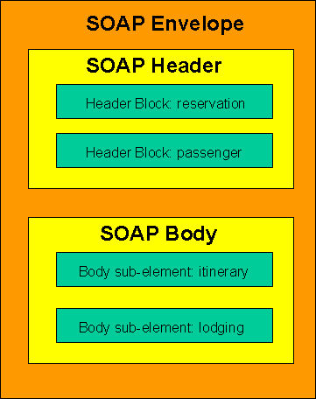
SOAP
What does a SOAP message look like?
<?xml version="1.0"?>
<soap:Envelope
xmlns:soap="http://www.w3.org/2003/05/soap-envelope"
soap:encodingStyle="http://www.w3.org/2001/12/soap-encoding">
<soap:Header>
<m:reservation xmlns:r="http://example.com/xsds/reservation" env:mustUnderstand="true">2013-03-19</m:reservation>
<n:passenger xmlns:n=http://example.com/xsds/passenger
env:mustUnderstand="true"> Aaron Evans</n:passenger>
</soap:Header>
<soap:Body>
<o:itinerary xmlns:o="http://www.example.org/itinerary">
<o:airline>DELTA</o:airline>
<o:departureTime> 6:08pm CDT</o:departureTime>
<o:departureAirport> 6:08pm CDT</o:departureAirport>
<o:departureGate>C13</o:departureGate>
…etc…
</soap:Body>
</soap:Envelope>
Web Services Explained
Notes:
See this image and message at http://www.w3.org/TR/soap12-part0/
The SOAP envelope wraps the soap message. It is the root element. It is required. It is what defines them XML document as a SOAP message
The xmlns:soap namespace defines the soap: prefix in an XML schema. This namespace defines the elements, attributes and values permitted in a soap message.
The ecodingStyle attribute defines the data types in the document. A SOAP message has no default encoding.
The SOAP header is optional.
The attributes defined in the SOAP Header define how a recipient should process the SOAP message.
They are defined by a SOAP application type. In this example, taken from the w3c reference, it defines a reservation and a passenger.
A SOAP header is a way to pass information that is not part of the application payload.

Slide 12
Heading
  text
Web Services Explained

Slide 13
Heading
  text
Web Services Explained

Slide 14
Heading
  text
Web Services Explained

